Slide 1
Community Forum
C o C

Slide 2
Why Revise the Code of Conduct?
Every 3 to 5 years it is good practice to gather stake holder input and revise the code of conduct to meet our students needs.
Post Pandemic it is important to check in and make sure the current code of Conduct is meeting our needs as a TUSD community.

Slide 3
Representative Stakeholders are Identified:
NAME | TITLE
Brian Lambert | Regional Superintendent
Anna Warmbrand | Director of Student Relations
Alicia Engelstad | Program Coordinator
Shermain Fort | Program Coordinator (AASS)
Monique Landrum | Behavior Specialist (MASS)
Cindy Hurley | Program Manager
Rachel Ruder | Program Coordinator (NASS)
Henri Nzeyimana | Program Coordinator (PAS)
Tamara Nicolosi | Vail Principal
Alissa Welch | Rincon Principal
Manny Padilla | Valencia Asst. Principal
Frank Rosthenhausler | Pueblo Principal
Eileen Gow | Dietz Asst. Principal
NAME | TITLE
Rosamaria Duarte Raub | Ochoa Principal
Judy Mitchell | Mary Meredith Principal
Rosie Zwaduk | TEA
Margaret Chaney | TEA
William Abaidoo | TEA
Murray Lewis | TEA
Jason Freed | TEA
Areli Zapata | Classified Rep
Michael Areinoff | Legal Counsel
Julie Coryell | Parent
Dr. Laronda Lugo | Parent
Escalante, Tina | Admin. Assistant (notetaker)

Slide 4
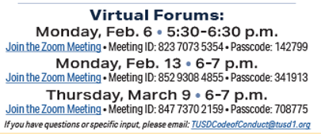
Timeline:
JANUARY:
Establish Norms
Establish committees for student forums, community forums, and survey content (administrators, staff, and community/parents)
Create content for the community forums
FEBRUARY:
Community Forums:
Palo Verde Library – Feb 8, 2023, 5:30-6:30 p.m.
Innovation Tech Library – Feb 9, 2023, 5:30-6:30 p.m.
Tucson High Library – Feb 15, 2023, 5:30-6:30 p.m.
Cholla Library – Feb 20, 2023, 5:30-6:30 p.m.
Sahuaro Library – March 8, 2023, 5:30-6:30 p.m.
Student Forums:
Sabino, Catalina, Santa Rita, UHS, Sahuaro, Rincon, Pueblo, Mary-Meredith, TAP/Project More
Create Survey Content

Slide 5
Timeline Continued:
MARCH:
Surveys are sent out the first week of March
Survey data is collected and analyzed
APRIL:
Data from Student Forums and community forums are shared with committee
Stakeholder input used to inform the revisions to the code of conduct
MAY:
Revised Code of Conduct is presented to the school board.

Slide 6
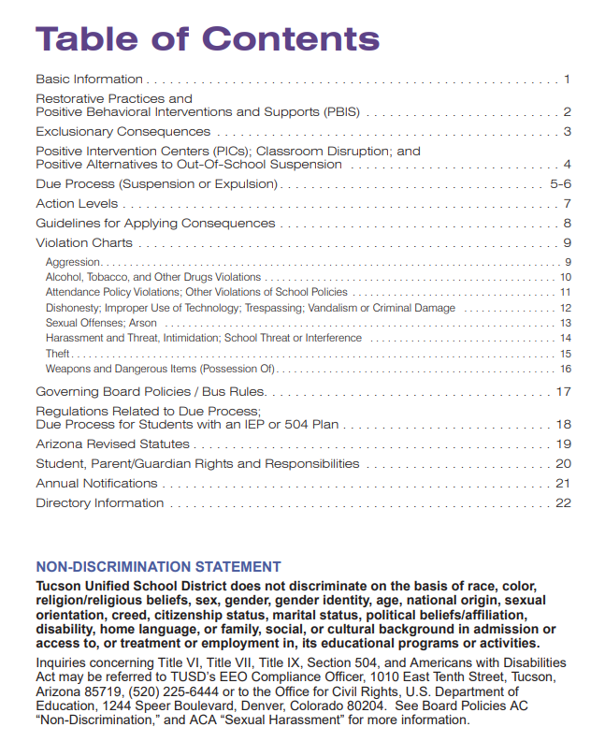
Code of Conduct LINK

Slide 7
TUSD Code of Conduct Resources
EMAIL: TUSDCodeofConduct@tusd1.org
Code of Conduct PDF
Code of Conduct Request Form
Desegregation
Equity, Diversity, and Inclusiveness

Slide 8
Open Forum:
1. Do you believe it is appropriate for the Dress Code to be included in the Code of Conduct? If so, what level of infraction?
2. Currently, after a student’s first fight, the consequence includes one day of suspension with a restorative mediation, and then the students are allowed back on campus. Does this seem appropriate?
3. Currently, the consequence for drug offenses includes a class about drug use, safety, and health. Should this be a continued practice/consequence/intervention?
4.Truancy is currently a level 2, is that an appropriate level?
5. Currently, “Defiance and Disrespect” has two levels. Level 3 is if the disrespect is towards an adult. Level 2 is if the disrespect is towards another student. Do you believe this is correctly labeled?

