Slide 1
ESSER I, II, III
Governing Board
February 8, 2022

Slide 2
Timeline
ESSER I – $18.5M
  Coronavirus Aid, Relief, & Economic Security (CARES) Act
  Enacted March 27, 2020
ESSER II - $76.3M
  Coronavirus Response & Relief Supplemental Appropriations (CRRSA) Act
  Enacted December 27, 2020
ESSER III - $172.9M
  American Rescue Plan (ARP)
  Enacted March 11, 2021

Slide 3
ESSER - Eligibility Requirements
ESSER - Eligibility Requirements
“ For the Prevention, Preparation, & Response to the Coronavirus Pandemic”
Academic Loss
Educational Technology
      Mental Health Support / Social Emotional Learning
      Distance Learning
      Personal Protective Equipment / Sanitation
      Minimizing Transmission (Learning Spaces)
      Recruitment / Retention

Slide 4
ESSER Decision Making
ESSER Decision Making
Allowable use of Funds and Grant Guidance
Immediate Needs & Response
Strategic Priorities
  Mitigation Measures
  Academic Recovery
  Long Term Investments, One Time Purchases

Slide 5
School Guidance
ESSER Decision Making
Core 5 Areas – School Guidance
Intervention – Math, Reading, RTI, Credit Recovery, Teaching Assistants
CSP – Curriculum Service Provider, Coaching of Teachers, Develop PD, Data, PLC support
MTSS – Multi Tiered Systems of Support, manage student data, interventions, school system, teachers
Social Worker – Social Work, Behavior, Families
Counselor – Counseling, College & Career, SEL

Slide 6
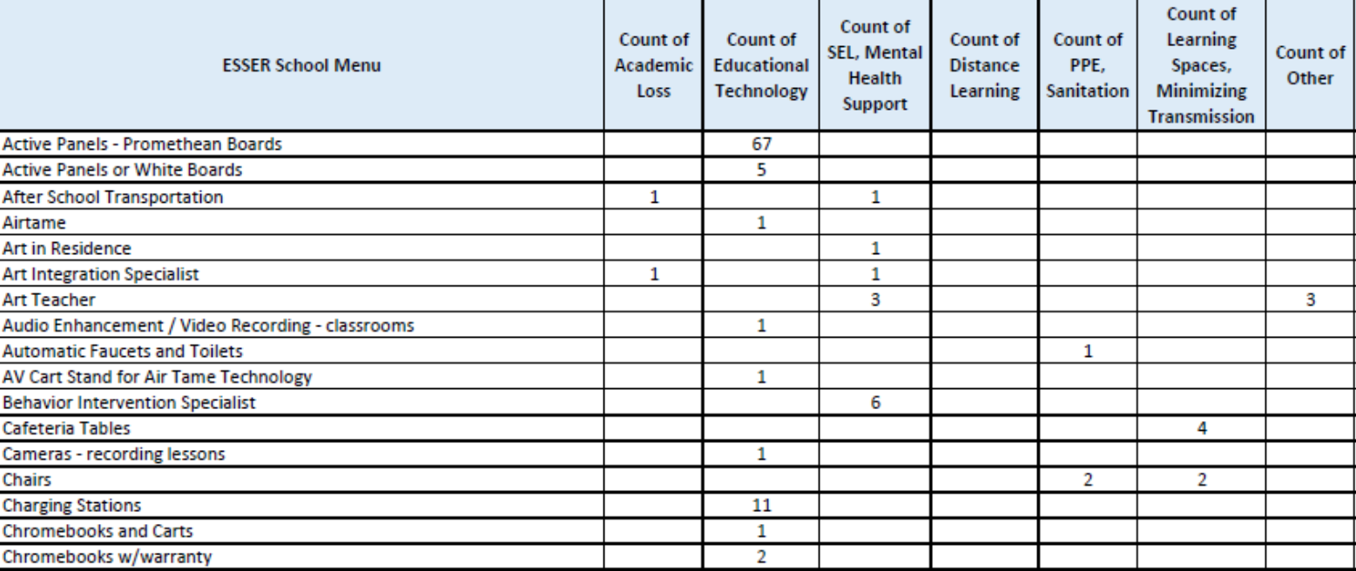
Menu Options-School Guidance
ESSER Decision Making
Menu Options – School Guidance

Slide 7
ESSER I Overview
ESSER I - Overview
ESSER I – $18.5M
  Funding is available through 9/30/22
  Private Schools received $872,230.76 as their proportionate share amount.
  TUSD received $17,685,868.62.
  Key Themes:
      Stabilizing Employment
      Health & Safety
      Virtual Learning

Slide 8
ESSER I – Allocations
ESSER I – Allocations
Summer School
Great Minds, Newsela, Rosetta Stone, Platform Athletics, Imagine Learning, Cengage, Verner, IXL, Gracenotes, Tech supplies/headsets, Make music, PPE/Safety supplies,
Laptops, chromebooks and related access, charging carts, document cameras, access points, ipads/tablets, projectors
Wifi Hot Spots
Zoom integration, Canvas cloud subscription
Instructional Items
Academic Loss
Distance Learning
Payroll & Benefits – Community Schools, Food Service Department
Payroll & benefits for subs, classified temp
Memberships for online curriculum resources
Technology warranties, cleaning services (PS)
Technology warranties
Covid insurance increase
PPE (gloves, masks, health services gowns, etc), thermometers, cleaning and sanitizing supplies, filters, water bottles, classroom supplies, desk barriers,
Air purifiers, bottle fillers, floor scrubbers, vacuums, sanitizing sprayers, utility carts, classroom furnishings, hand-wash stations,
14-passenger bus, preparation, service and parts, social distancing needs
Staff laptops and accessories, 3D printer,
Graduation events rental social distance items
Health Safety communication – printing, mailing
Student water bottles
Support Service Items
Educational Technology
Distance Learning
PPE/Sanitation
Retention

Slide 9
ESSER I – Financial Summary
ESSER I – Financial Summary

Slide 10
ESSER II - Overview
ESSER II - Overview
ESSER II - $76.3M
  Funding is available through 9/30/23
  No Private School Allocations required
  School Plans – $350,000 per school
  Department Plans – Proposal process, guided by immediate needs and current situation
  Key Themes :
      Virtual Learning Needs (1:1 computer initiative)
      Minimizing Transmission (Learning Spaces)
      Stipends

Slide 11
Allocations-Departments, Schools
ESSER II – Allocations
Allocations
Departments
Schools (identified by CORE 5 positions in green)
* Attachment - ESSER II Approved Spending Plan FY22

Slide 12
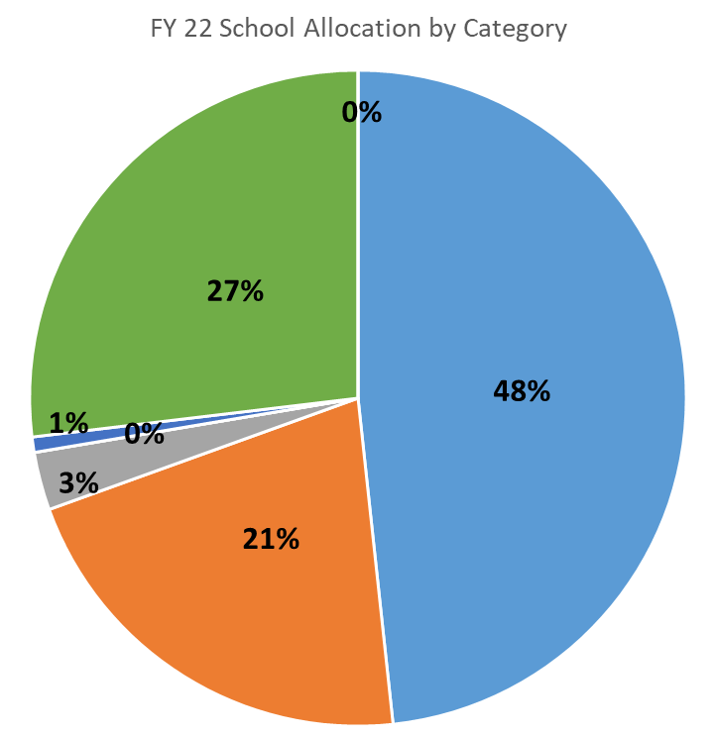
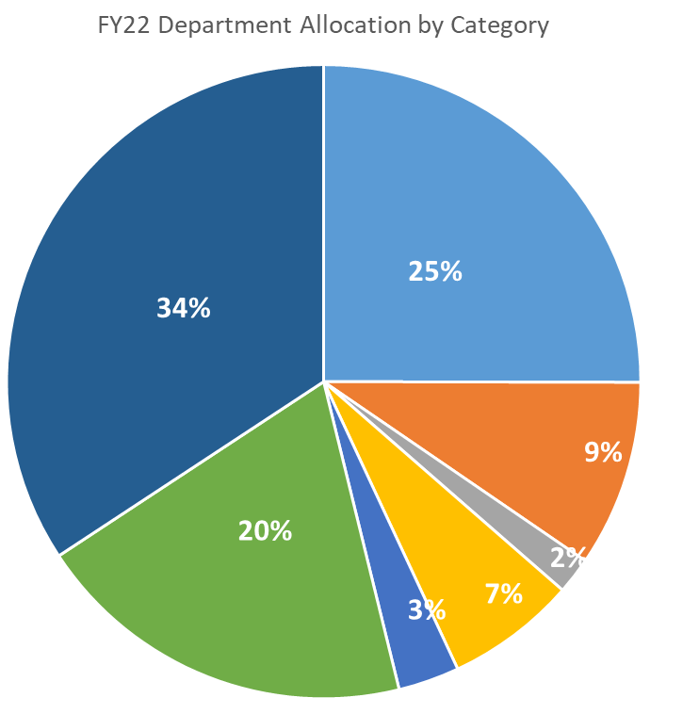


ESSER II - Allocations
ESSER II – Allocations
* Attachment – FY 22 ESSER II Allocations
Academic Loss
Educational Technology
Mental Health (SEL)
Distance Learning
PPE / Sanitation
Minimizing Transmission (Spaces)
Other / Recruitment Retention

Slide 13
School Allocations by Category
ESSER II – Allocations
School Allocations by Category
* Attachment - ESSER II Approved Spending Plan FY22

Slide 14
Staffing
ESSER II – Staffing
* Attachment – FY22 ESSER II FTE
Filled FTE: 227.64
Vacant FTE: 172.04
56.9% fill rate
74 Schools were able to hire
TUVA Created

Slide 15

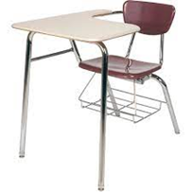
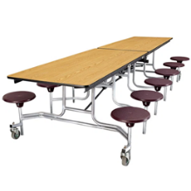
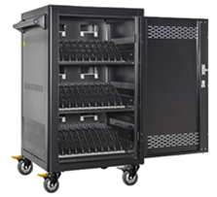

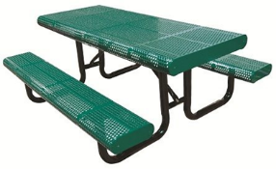

ESSER II - Items
ESSER II – Items
School Items by Category (Summarized, not all inclusive)

Slide 16
ESSER II - Projects
ESSER II – Projects
Actual Costs & Started
$2 Million
45 Projects
Pending Costs & Not Started
$2 Million
34 Projects
Totals
$4 Million
79 Projects
Funding for all projects funded from ESSER II is available through 9/30/23.
Unfinished projects will continue into the ’22-’23 school year.

Slide 17
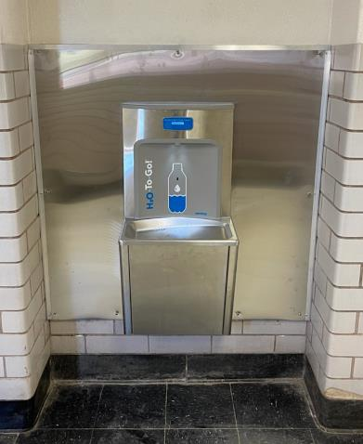
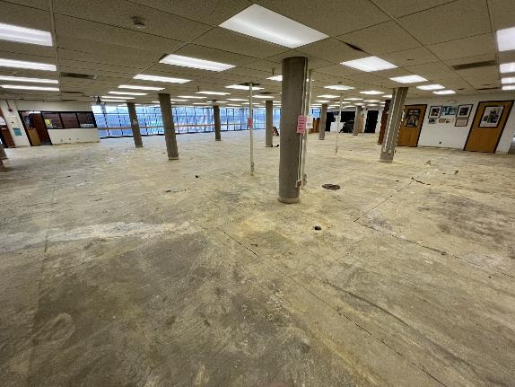
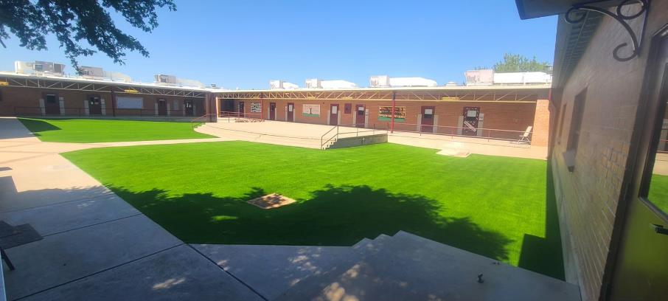
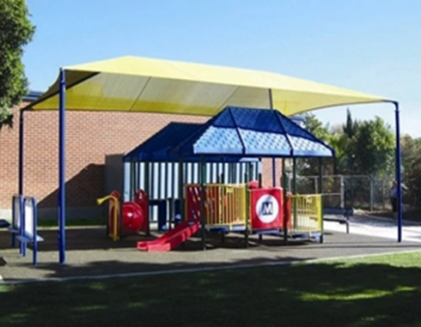
ESSER II Projects continued
ESSER II – Projects
79 Projects
54 Sites
Outdoor Learning Spaces
Safety/Health Modifications

Slide 18
Financial Summary
ESSER II – Financial Summary
Unspent Areas:
Summer School
30% Kindergarten
Schools

Slide 19
ESSER III Overview
ESSER III - Overview
ESSER III - $172.9M
  Funding is available through 9/30/24
  No Private School Allocations required
  Governing Board requests monthly as an Immediate Needs Action Item.
  School Plans – $350,000 per school for FY23
  District Plans – Determined by current situation.

Slide 20
ESSER III - Financial Summary
ESSER III - Financial Summary
Approved Allocations
$40,868,944.01
Remaining Funds
$132,056273.31
Immediate Needs submitted monthly
School & District Plans submitted in June 2022
* Attachment – ESSER III Governing Board Approval

Slide 21
ESSER III Financial Summary
ESSER III – Financial Summary

Slide 22
Questions
Questions?

