Slide 1
ESSER I, II, III Projected Financial Capacity
Governing Board
April 12, 2022

Slide 2
ESSER - Eligibility Requirements
ESSER - Eligibility Requirements
“ For the Prevention, Preparation, & Response to the Coronavirus Pandemic”
Academic Loss
Educational Technology
Mental Health Support / Social Emotional Learning
Distance Learning
Personal Protective Equipment / Sanitation
Minimizing Transmission (Learning Spaces)
Recruitment / Retention

Slide 3
ESSER Decision Making
ESSER Decision Making
Allowable use of Funds and Grant Guidance
Immediate Needs & Response
Strategic Priorities
Mitigation Measures
Academic Recovery
Long Term Investments
One Time Purchases

Slide 4
ESSER I, II, III Timeline
ESSER I – $18.5M
Funds all allocated, final purchases occurring.
Final Allocations Decided – September 30, 2021
ESSER II - $76.3M
Funds allocated, final FY22 purchasing just finished, unspent funds being identified.
Final Allocations Decided – September 30, 2022
ESSER III - $172.9M
Governing Board approved items purchased, FY23 funds allocated to schools, *20% required for Academic Loss.
Final Allocations Decided – September 30, 2023
Notes:
Final allocation dates are key dates that will be explained in more detail later.
ESSER III – 20% Academic Loss = 34.5M – This is a requirement that we have allocated for, but I will need to monitor this closely as we go through next year.
Examples of 20% set-aside : Intervention teacher positions, RTI teachers, Counselors, Social Workers, 30% KG teachers, Summer School, Tutoring

Slide 5
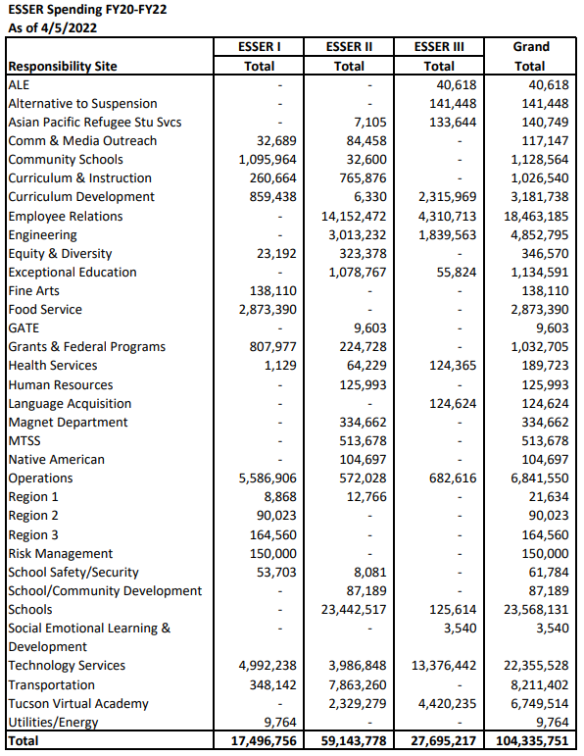
ESSER Financial Summary
ESSER I, II, III – Financial Summary
Total Award | 267,879,953
Total Spent 4/5/22 | 104,335,751
Difference | 163,544,202
Approved & Allocated but Uncommitted | 31,487,929
Remaining Balance | 132,056,273
Approved & Allocated but Not Yet Committed
Vaccine Stipends | 1.5
Student/staff devices, classroom technology | 7.7
Summer School, FY22 | 5.6
Uncommitted schools $350k, FY22 | 4.3
FY23 Employee benefits | 1.0
Open school projects | 2.0
Operations mitigation supplies | 1.5
HVAC retrocommissioning | 1.4
Full Day Kinder, FY22 | 2.8
Instructional Aids/Curriculum | 3.6
Subtotal | 31.4
Notes:
Left Side – spending as of 4/5/22 for all ESSER grants. $104,335,751 spent
Right Side – summary of all 3 grants together, not a detailed breakdown of each one.
Allocated, but uncommitted, blend of ESSER II and III items = changes daily, but uncommitted amounts will occur, this will create extra funds to reallocate.

Slide 6
ESSER I, II, III Financial Summary
ESSER I, II, III – Financial Summary
Total Award | 267,879,953
Total Spent | 104,335,751
Difference | 163,544,202
Approved & Allocated but Uncommitted | 31,487,929
Remaining Balance | 132,056,273
After Recurring costs: | -$59M Remaining = $73M Vaccine Uncommitted +1.5M FY 22 School Uncommitted +3.0M Remaining = $77.5M
$2500 stipend x 3 semesters = $7,500 / employee | -$63M Remaining = $14.5M
ESSER III Indirect Cost (3.11%) | -4.5M Remaining = $10.5M
Notes:
This is a summary of all 3 grants, not a detailed breakdown of each one.
Recurring Costs = items that have been previously approved by GB and that we anticipate will still be supported.
District FTE = operations managers, grants coordinator, social worker, CSPs, SEL director, NA MTSS facilitators, HR Analyst
Uncommitted = projections of cost savings due to funds not being used.
Stipends – exciting use of funds, retention/recruitment opportunities it creates, changed the landscape and what is available going forward.
Indirect Costs = accounting expenses, utilities, supplies, basic M&O type expenses. These are not detailed, but applied to our general budget.
Governing Boards decision is you would like to take indirect costs or not – taking them would leave remaining amount at 10.5M, not taking indirect would leave the total at 14.5M

Slide 7
2022 Timeline of Key Decisions
2022 ESSER – Timeline of Key Decisions
June 30, 2022
Deadline for all ESSER funded Capital Projects
December 31, 2022
ESSER II Grant Locked – Completion Report finished, Final application submitted, grant locked in through 9/30/23.
August 31, 2022
September 30, 2022
September 30, 2022
All FY22 ESSER II Purchases Finalized. Unspent funds compiled and totaled.
ESSER II Grant - Final funding decisions need to be made for allocations through 9/30/23.
End of ESSER I Grant
Notes:
2022 – Primarily ESSER II
August 31 is important because this will allow us to provide a clear picture of how much is available from ESSER II.

Slide 8
2023 ESSER – Timeline of Key Decisions
2023 ESSER – Timeline of Key Decisions
April 2023
FY23 ESSER III School & Department Spending Finished
December 31, 2023
ESSER III Grant Locked – Completion Report finished, final application submitted, grant locked in through 9/30/24.
August 31, 2023
September 30, 2023
September 30, 2023
All FY23 ESSER III Purchases Finalized. Unspent funds compiled and totaled.
ESSER III Grant - Final funding decisions need to be made for allocations through 9/30/24.
End of ESSER II Grant
Notes:
2023 – primarily ESSER III
August 31 is important because this will allow us to provide a clear picture of how much is available from ESSER II.

Slide 9
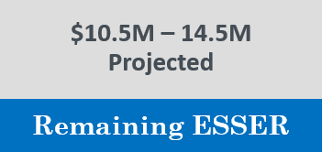
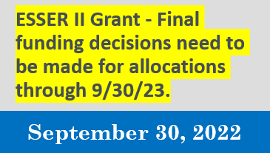
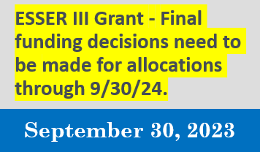
ESSER – Key Decisions Summary
ESSER – Key Decisions Summary
Notes:
ESSER II – 9/30/22 final decisions needed – August is our target date to get actual dollar amounts
ESSER III – 9/30/23 final decisions needed
Questions – Clarification needed?
GB Requests are next….

Slide 10
Questions?
Questions?

