Slide 1
ESSER I, II, III
Financial Summary
Governing Board
September 13, 2022

Slide 2
ESSER Eligibility Requirements
ESSER - Eligibility Requirements
“ For the Prevention, Preparation, & Response to the Coronavirus Pandemic”
Academic Loss
Educational Technology
      Mental Health Support / Social Emotional Learning
      Distance Learning
      Personal Protective Equipment / Sanitation
      Minimizing Transmission (Learning Spaces)
      Recruitment / Retention

Slide 3
ESSER Decision Making
ESSER Decision Making
Allowable use of Funds and Grant Guidance
Immediate Needs & Response
Strategic Priorities
  Mitigation Measures
  Academic Recovery
  Long Term Investments
  One Time Purchases

Slide 4
ESSER I, II, III Timeline
ESSER I – $18.5M
  Funds all allocated, final purchases occurring.
  Grant Concludes – September 30, 2022
ESSER II - $76.3M
  Funds allocated, final FY22 purchasing finished, unspent funds being identified.
  Final Allocations Decided – September 30, 2022
ESSER III - $172.9M
  Governing Board approved items purchased, FY23 funds allocated to schools, *20% required for Academic Loss.
  Final Allocations Decided – September 30, 2023
Notes:
ESSER III – 20% Academic Loss = 34.5M – This is a requirement that we have allocated for, but I will need to monitor this closely as we go through next year.
Examples of 20% set-aside : Intervention teacher positions, RTI teachers, Counselors, Social Workers, 30% KG teachers, Summer School, Tutoring

Slide 5
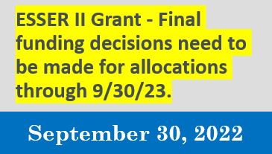
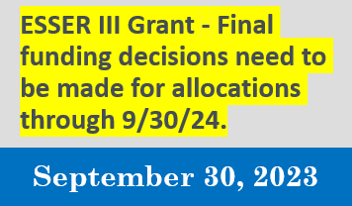
Key Dates
Key Dates
Notes:
ESSER II – 9/30/22 final decisions needed – August is our target date to get actual dollar amounts
ESSER III – 9/30/23 final decisions needed
Questions – Clarification needed?
GB Requests are next….

Slide 6
21-22 School Year Summary
‘21-
‘21-’22 School Year Summary
ESSER II
$350,000 School
Funded 272.57 FTE ($7.2M)
Funded 110 capital projects at schools ($5.1M)
Curriculum and Classroom Instructional Aids ($2M )
Capital Items ($3M)
Technology ($5.5M)
ESSER III
Governing Board approved $157.4M during ‘21-’22 SY
1:1 Laptops ($14M)
HVAC Projects ($1.4M)
Vaccine Stipends ($5.8M)
Insurance Increase ($1M)
Retention Stipends ($63M)
Notes:
ESSER III – 9/30/23 final decisions needed
Questions – Clarification needed?
GB Requests are next….

Slide 7
ESSER II Staffing Summary
ESSER II – Staffing Summary
Position | Salary | FTE
6/5th Position | $501,220.51 | 15.00
Behavior Intervention Monitor | $9,032.50 | 1.00
Behavior Specialist | $96,702.54 | 5.00
Counseling Intern | $45,948.20 | 2.50
Counselor | $155,395.91 | 4.30
Curriculum Service Provider | $626,352.44 | 15.40
Custodian | $30,276.21 | 4.00
Enrollment Coordinator | $65,130.86 | 3.00
HR Analyst | $40,646.31 | 1.00
HR Associate | $39,483.38 | 2.00
Instructional Data Intervention Specialist | $82,384.06 | 2.00
Instructional Specialist | $142,160.64 | 11.00
Instructional Specialist - General Subject | $23,783.25 | 1.41
Library Assistant | $15,088.13 | 0.75
Library Media Specialist | $74,568.12 | 2.00
Multi-Tiered System of Support Facilitator (MTSS) | $1,018,563.70 | 21.50
Program Coordinator - College & Career Readiness | $22,399.11 | 0.50
Program Coordinator - Grants | $107,154.17 | 2.00
Program Coordinator, Senior - TUVA | $72,067.44 | 1.00
Project Technical Specialist | $45,465.26 | 1.00
Position | Salary | FTE
Registrar | $30,890.06 | 1.00
Restorative Practice Facilitator | $29,664.46 | 1.00
School Community Liaison | $77,903.91 | 6.15
School Site Office Manager | $45,338.94 | 1.00
School Site Technology Liaison | $81,701.82 | 5.50
Social Worker | $170,510.99 | 5.30
Student Family Support Liaison | $29,854.30 | 1.00
Student Success Specialist | $123,169.26 | 5.00
Teacher | $746,454.36 | 21.00
Teacher - ELD | $81,420.66 | 2.00
Teacher - Elementary | $39,150.73 | 1.40
Teacher - Fine Arts | $44,300.00 | 1.00
Teacher - Kinder | $69,536.11 | 2.00
Teacher - Math Interventionist | $74,379.04 | 1.70
Teacher - Reading Interventionist | $217,775.99 | 5.40
Teacher - RTI | $969,222.73 | 30.65
Teacher - Secondary | $206,780.19 | 6.00
Teacher Assistant | $968,567.18 | 77.66
Teacher Assistant - Bilingual | $8,314.54 | 0.45
Grand Total | $7,233,057.58 | 272.57
Notes:
ESSER III – 9/30/23 final decisions needed
Questions – Clarification needed?
GB Requests are next….

Slide 8
ESSER I, II, III Financial Summary Summer 2022
ESSER I, II, III – Financial Summary – Summer 2022
Total Award | 267,879,953
Total Spent | 104,335,751
Difference | 163,544,202
Approved & Allocated – FY22 In Progress | 31,487,929
Remaining Balance | 132,056,273
After Recurring costs: | -$52M Remaining = $80M
$2500 stipend x 3 semesters = $7,500 / employee | -$63M Remaining = $17M *Projection from Summer 2022
Notes:
Recurring Costs = items that have been previously approved by GB and that we anticipate will still be supported.
District FTE = operations managers, grants coordinator, social worker, CSPs, SEL director, NA MTSS facilitators, HR Analyst
Uncommitted = projections of cost savings due to funds not being used.
Stipends – exciting use of funds, retention/recruitment opportunities it creates, changed the landscape and what is available going forward.
Indirect Costs = accounting expenses, utilities, supplies, basic M&O type expenses. These are not detailed, but applied to our general budget.
Governing Boards decision is you would like to take indirect costs or not – taking them would leave remaining amount at 10.5M, not taking indirect would leave the total at 14.5M

Slide 9
ESSER I, II, III – Financial Summary – 6.30.22
ESSER I, II, III – Financial Summary – 6.30.22
Notes:
Recurring Costs = items that have been previously approved by GB and that we anticipate will still be supported.
District FTE = operations managers, grants coordinator, social worker, CSPs, SEL director, NA MTSS facilitators, HR Analyst
Uncommitted = projections of cost savings due to funds not being used.
Stipends – exciting use of funds, retention/recruitment opportunities it creates, changed the landscape and what is available going forward.
Indirect Costs = accounting expenses, utilities, supplies, basic M&O type expenses. These are not detailed, but applied to our general budget.
Governing Boards decision is you would like to take indirect costs or not – taking them would leave remaining amount at 10.5M, not taking indirect would leave the total at 14.5M

Slide 10
20% Academic Loss
20% Academic Loss
*The following items are what ADE has approved as Academic Loss

Slide 11
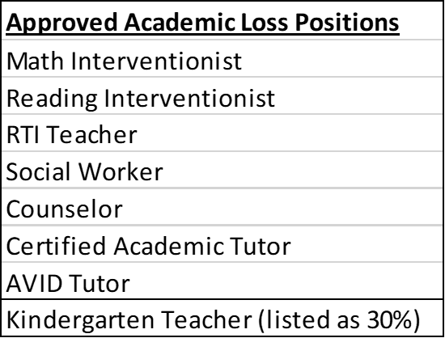

20% Academic Loss continued
20% Academic Loss
Listed below are recommendations to meet the 20% Academic Loss Requirement. $14,501,005.88 additional needs to be spent.
* Items are new and will be reviewed on the allocation requests slide

Slide 12
Academic Loss
ESSER III – Allocation Request
Notes:
ESSER III – 9/30/23 final decisions needed
Questions – Clarification needed?
GB Requests are next….

Slide 13
ESSER III – Final Projection
ESSER III – Final Projection
Considerations
Principals were asked to fill 5 core positions with ESSER funds. Interventionists, Counselors, & Social Workers count as academic loss (pending board approval will be funded for ‘23-’24 school year). MTSS and CSP positions do not qualify as academic loss (not currently funded for ‘23-’24, 50 FTE, $3.4M).
Allocated but unspent funds will affect final numbers. Our projection in Spring 2022 ($14M) ended up larger by Fall 2022 ($19M).
Notes:
ESSER III – 9/30/23 final decisions needed
Questions – Clarification needed?
GB Requests are next….

Slide 14
Indirect Rate
Indirect Rate
Using ESSER III indirect rate is an option
Indirect rate is 3.11%
Max amount available = $5,072,595.77
Taking less than the max is an option
Based on what we need to save for Academic Loss, the max we could take is $4,212,691.88

Slide 15
Final Projection
ESSER III – Final Projection
Considerations
Principals were asked to fill 5 core positions with ESSER funds. Interventionists, Counselors, & Social Workers count as academic loss (pending board approval will be funded for ‘23-’24 school year). MTSS and CSP positions do not qualify as academic loss (not currently funded for ‘23-’24, 50 FTE, $3.4M).
Allocated but unspent funds will affect final numbers. Our projection in Spring 2022 ($14M) ended up larger by Fall 2022 ($19M).
Notes:
ESSER III – 9/30/23 final decisions needed
Questions – Clarification needed?
GB Requests are next….

Slide 16
Recommendations
Recommendations
Reserve $15,088,835 for Academic Loss
Approve allocation request of $896,000 (two academic loss items)
Do not allocate the remaining $4,212,691 right now
Review options at a future board meeting.

Slide 17
Governing Board Study/Action
Questions or Discussion Regarding ESSER I, II, III Financial Summary.
Approval of Recommendations

